Slide 1
Early Development of the Cardiovascular System I

Slide 2
The cardiogenic field from which the heart, blood vessels and blood cells will develop is created during gastrulation and at first lies at the cranial end of the embryo before folding occurs.
As development of the cardiovascular system gets underway, a pair of tubes endocardial tubes) develops within the cardiogenic field in the 3rd week of development.
The endocardial tubes are brought together during embryonic folding and fuse in the mid-line to create the primitive heart tube.
The primitive heart tube is linear at first, receiving blood (inflow) at its caudal pole and pumping blood (outflow) from its cranial pole. The primitive heart tube is described as having four segments the (primitive) atrium, the (primitive) ventricle, bulbus cordis and truncus arteriosus. Early in its development the cardiovascular system (heart and vasculature) is highly symmetrical in marked contrast to the adult disposition.

Slide 3
The symmetrical arrangement of embryonic/fetal blood vessels is systematically remodelledover the course of development. The process by which the adult disposition of the heart isachieved begins with the process of looping of the primitive heart tube. Put simply, looping places both the inflow and outflow cranially with the inflow dorsal to (behind) the outflow.
Evidence for the embryonic structures of the primitive heart tube persists in the adult (see also 2nd lecture). With further growth and development the primitive atrium contributes a (small) component to each atrium, the bulbuscordis give rise to (part of) the right ventriclewhile the left ventricle is derived from the primitive ventricle. The truncusarteriosus ultimately gives rise to the roots and proximal portions of the pulmonary trunk and aorta.

Slide 4
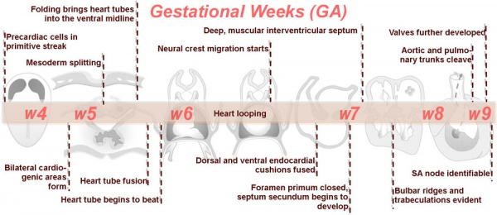

Slide 5
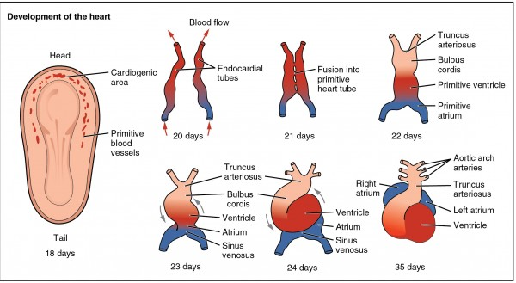

Slide 6
